Slide 1
ME230: Project Pitch Presentation Claw Machine Team: Denis Fulks, Gabe Rapp

Slide 2
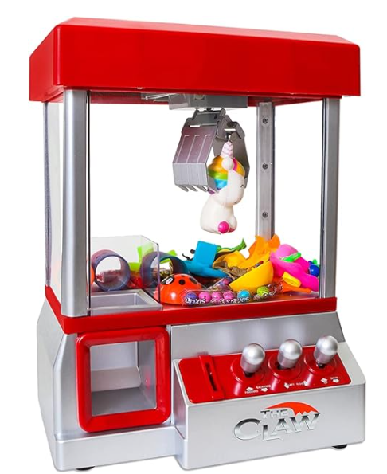
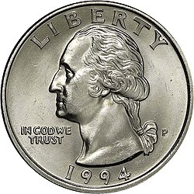
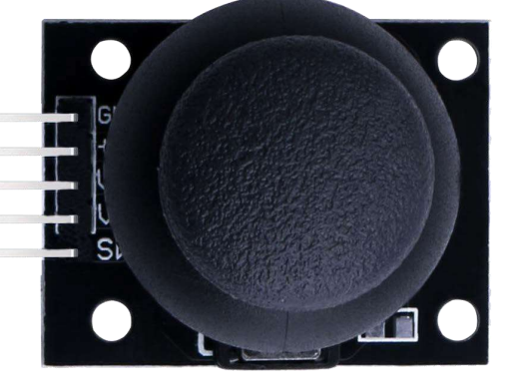
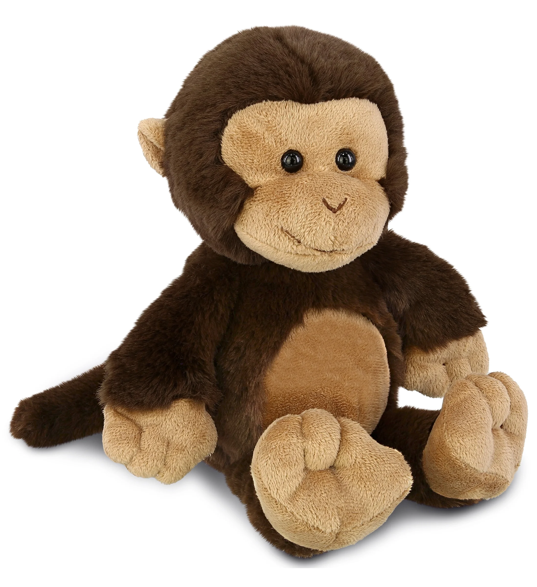
The Mini Claw Machine
Gantry System
FUN
Claw
Coin Slot
Conversation
Starter
Easily
Stored
Joystick

Slide 3
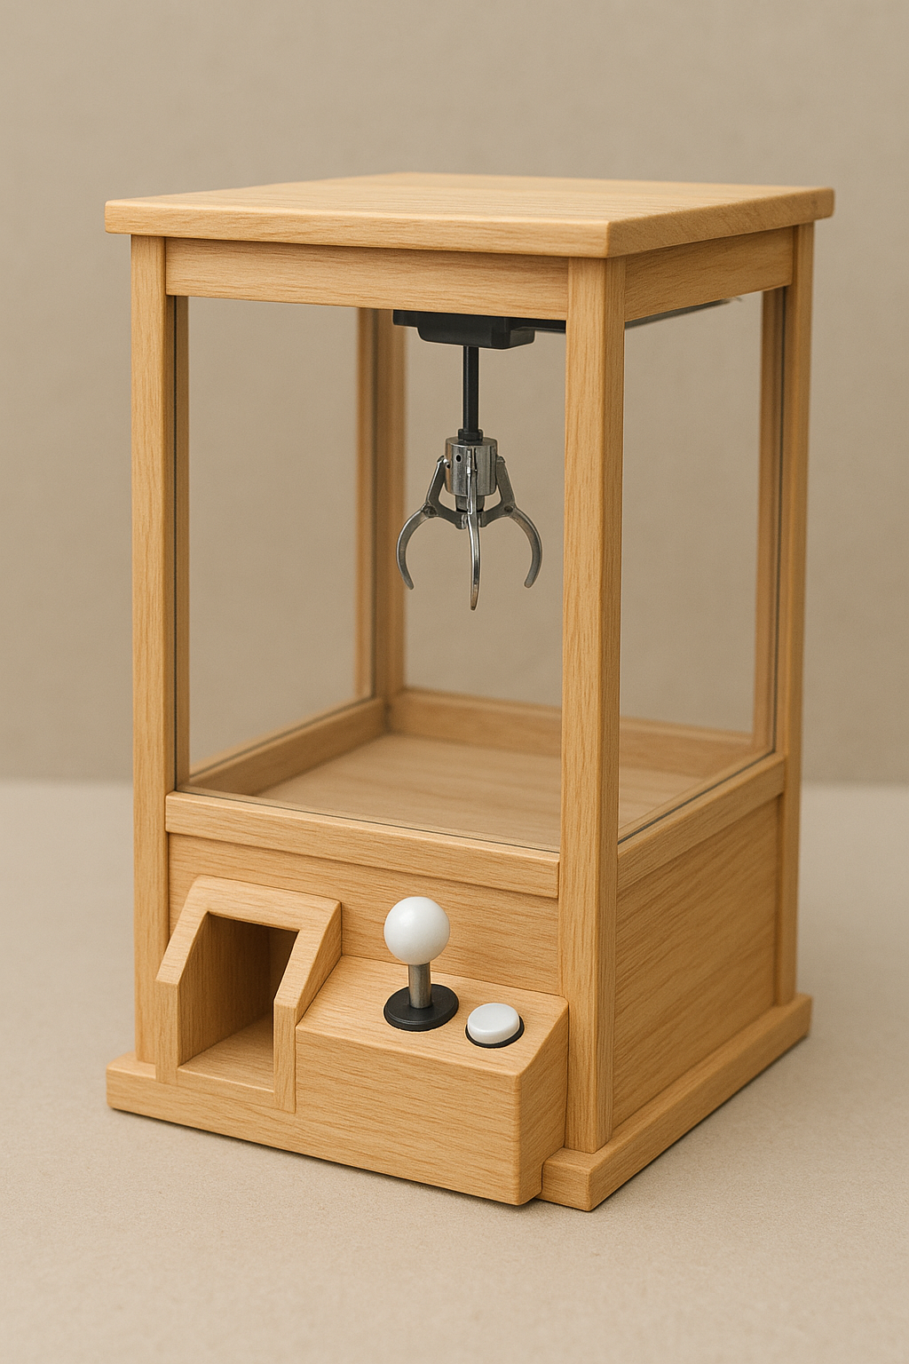
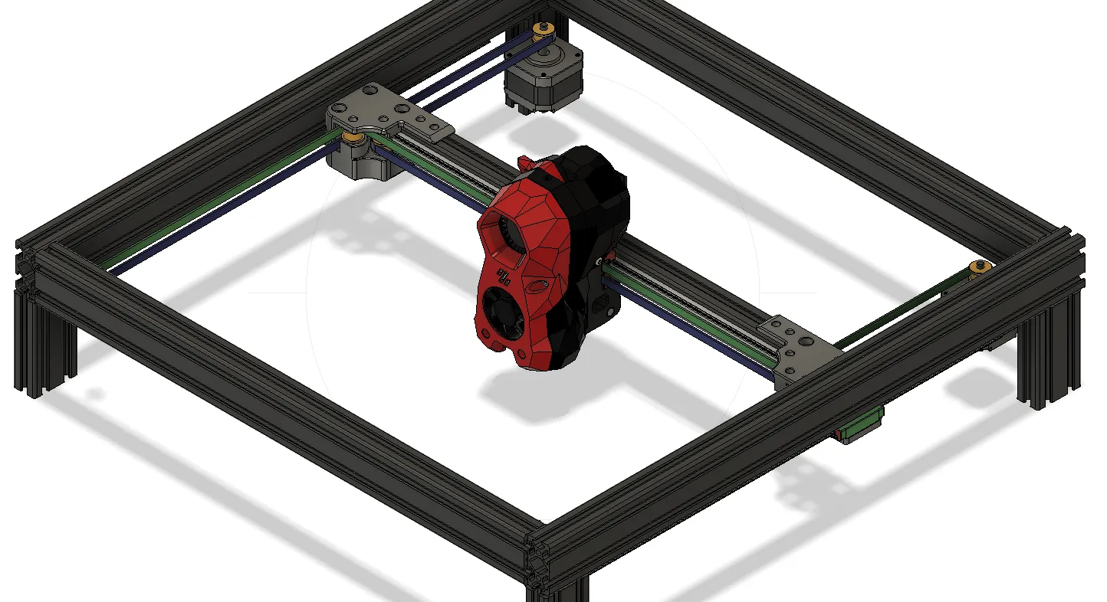
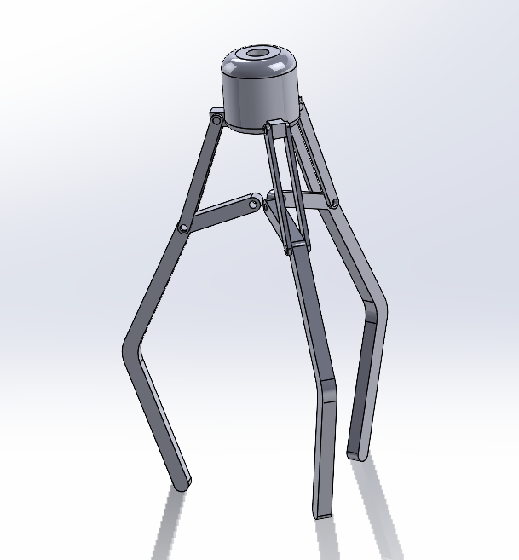
Construction
Proposed:
80-20 Gantry Frame (above)
2ft x 2ft (may go smaller)
Claw (right)
Wooden Frame w/ finish (left)
Various 3d printed parts
Need a decent and cheap material for the clear walls

Slide 4
Inputs
Sensor Name | Signal Type | What will it measure? What event(s) will it detect?
Button | Digital | The sensor will get a touch input to drop the crane and run the pickup sequence. (Would like to find a bigger one)
2-axis Joystick | Analog | The sensor will read an x/y directional input and move the claw in that direction at a constant speed. (Would need to make a custom grip)
Limit Switch x4 | Digital | The sensor will detect the bounds of the gantry, so it doesn’t attempt to move to an out-of-bounds region. It will also help with the homing.
Photoresistor/LED | Analog | To Sense a coin in the coin slot.

Slide 5
Outputs
Output Name | Power Requirements | How will you modulate this output?
DC Motor x3 | Supply Voltage: 12V Max. Current: 55mA | Will be used to drive the gantry x/y and crane drop. (May need something larger like this)
Servo | Supply Voltage: 6V Max. Current: 90mA | Will be used to actuate the claw.
LCD Display | Supply Voltage: 5V Max. Current: 1.5mA | Display messages to the user.
7-Segment Clock | Supply Voltage: 5V Max. Current: 1.5mA | Display timer to the user.

Slide 6
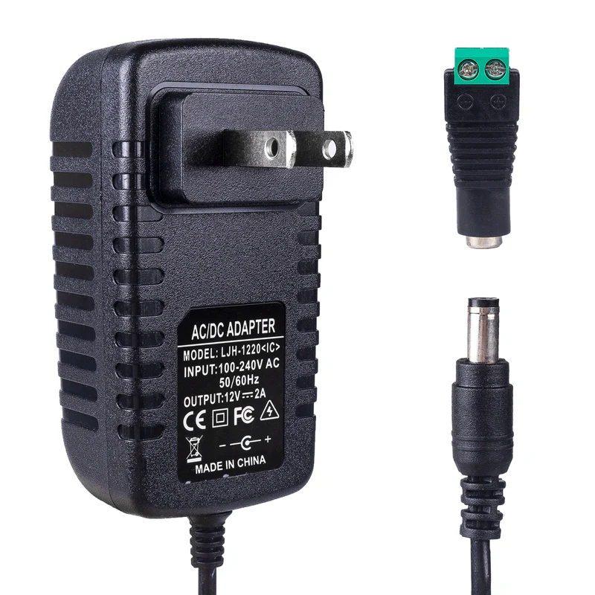
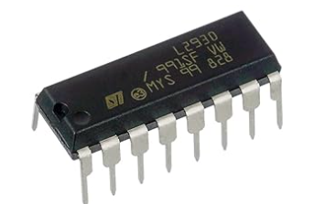
2 H-bridge motor drivers
Actuate the motors
Allow for bi-directionality
12V Power Supply
Power the motors
Power the peripherals

Slide 7
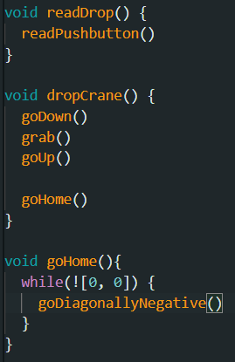
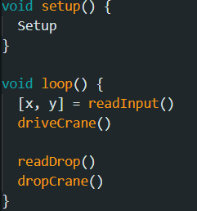
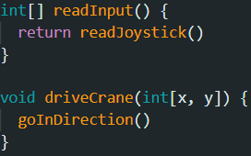
The Code

Slide 8
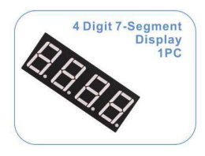
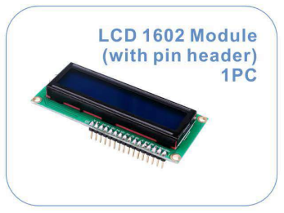
Timer – Counts down until the claw automatically drops
Display
Insert coin! (to begin playing)
Play! (time to move the claw)
Winner!
Loser!

